Slide 1
COMPONENT LEVEL ,USER INTERFACE, AND PATTERN BASED DESIGN
Session 11
Course : Software Engineering
Effective Period : Desember 2017

Slide 2
These slides have been adapted from
Pressman, R.S. (2015). Software Engineering : A Practioner's Approach. 8th ed. McGraw-Hill Companies.Inc, Americas, New York. ISBN : 978 1 259 253157. Chapter 14, 15 and 16
Acknowledgement

Slide 3
LO 2 : Explain the software engineering practices
Learning Objectives

Slide 4
Contents
What is a Component ?
Designing Class-Based Component
Conducting Component Level Design
Component Level Design for Web and Mobile Apps
Designing Traditional Components
The Golden Rules
User Interface Analysis and Design
Interface Analysis
Interface Design Steps
Web Apps and Mobile Interface Design

Slide 5
Contents
Design Patterns
Pattern-Based Software Design
Architectural Patterns
Component Level Design Patterns
User Interface Design Patterns
Web App Design Patterns
Patterns for Mobile Apps

Slide 6
What is a Component?
OMG Unified Modeling Language Specification [OMG01] defines a component as
  “… a modular, deployable, and replaceable part of a system that encapsulates implementation and exposes a set of interfaces.”
OO view: a component contains a set of collaborating classes
Conventional view: a component contains processing logic, the internal data structures that are required to implement the processing logic, and an interface that enables the component to be invoked and data to be passed to it.

Slide 7
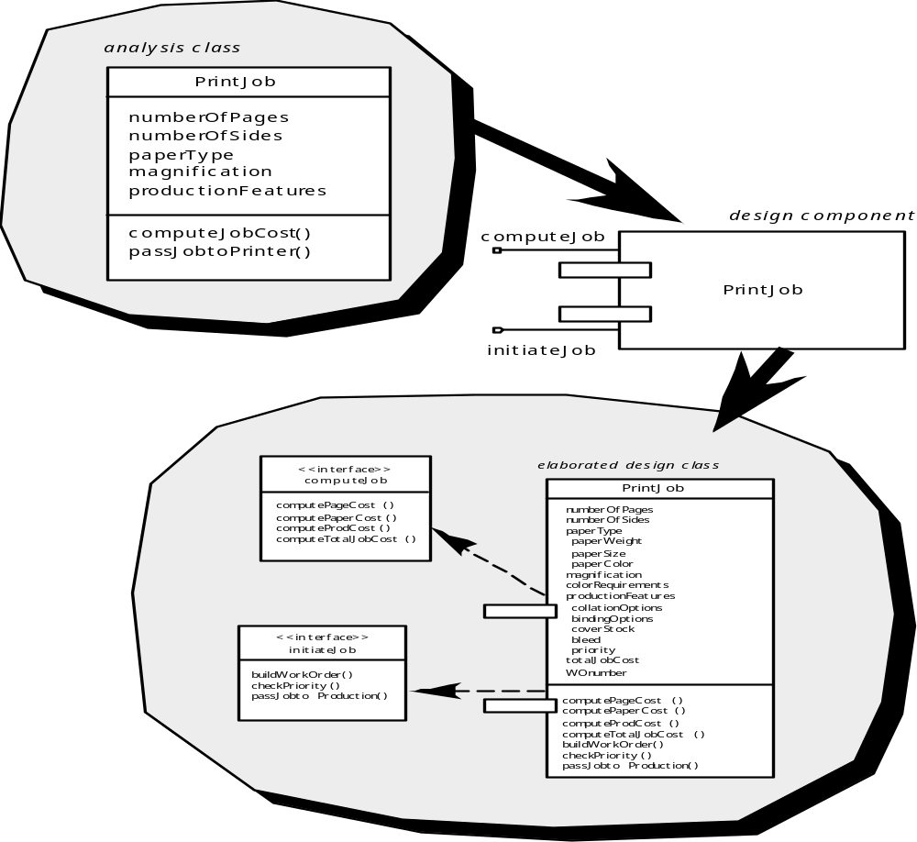
What is a Component?
OO Component

Slide 8
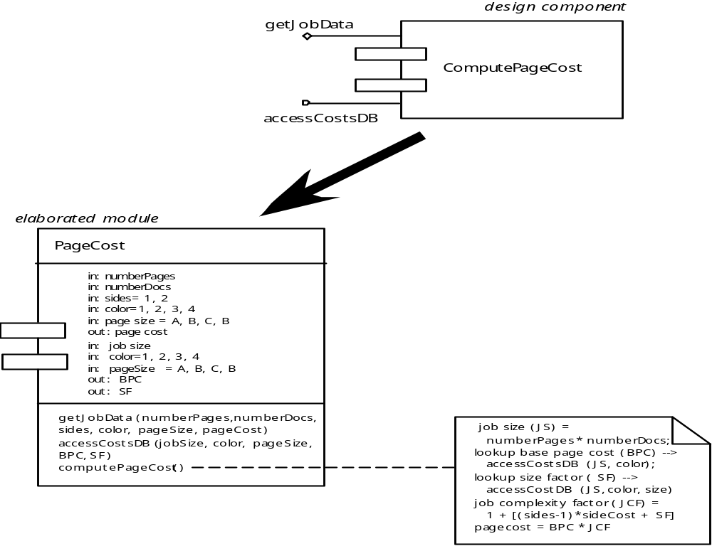
Conventional Component
What is a Component?

Slide 9
Designing Class-Based Components
Basic Design Principles
The Open-Closed Principle (OCP). “A module [component] should be open for extension but closed for modification.
The Liskov Substitution Principle (LSP). “Subclasses should be substitutable for their base classes.
Dependency Inversion Principle (DIP). “Depend on abstractions. Do not depend on concretions.”
The Interface Segregation Principle (ISP). “Many client-specific interfaces are better than one general purpose interface.
The Release Reuse Equivalency Principle (REP). “The granule of reuse is the granule of release.”
The Common Closure Principle (CCP). “Classes that change together belong together.”
The Common Reuse Principle (CRP). “Classes that aren’t reused together should not be grouped together.”

Slide 10
Component-Level Design Guidelines
Designing Class-Based Components
Components
  Naming conventions should be established for components that are specified as part of the architectural model and then refined and elaborated as part of the component-level model
Interfaces
  Interfaces provide important information about communication and collaboration (as well as helping us to achieve the OPC)
Dependencies and Inheritance
  it is a good idea to model dependencies from left to right and inheritance from bottom (derived classes) to top (base classes).

Slide 11
Cohesion
Designing Class-Based Components
Conventional view:
  the “single-mindedness” of a module
OO view:
  cohesion implies that a component or class encapsulates only attributes and operations that are closely related to one another and to the class or component itself
Levels of cohesion
  Functional
  Layer
  Communicational
  Sequential
  Procedural
  Temporal
  utility

Slide 12
Coupling
Designing Class-Based Components
Conventional view:
  The degree to which a component is connected to other components and to the external world
OO view:
  a qualitative measure of the degree to which classes are connected to one another
Level of coupling
  Content
  Common
  Control
  Stamp
  Data
  Routine call
  Type use
  Inclusion or import
  External

Slide 13
Conducting Component
Level Design
Step 1. Identify all design classes that correspond to the problem domain.
Step 2. Identify all design classes that correspond to the infrastructure domain.
Step 3. Elaborate all design classes that are not acquired as reusable components.
Step 3a. Specify message details when classes or component collaborate.
Step 3b. Identify appropriate interfaces for each component.

Slide 14
Conducting Component
Level Design
Step 3c. Elaborate attributes and define data types and data structures required to implement them.
Step 3d. Describe processing flow within each operation in detail.
Step 4. Describe persistent data sources (databases and files) and identify the classes required to manage them.
Step 5. Develop and elaborate behavioral representations for a class or component.
Step 6. Elaborate deployment diagrams to provide additional implementation detail.
Step 7. Factor every component-level design representation and always consider alternatives.

Slide 15
Component-Level Design for Web and Mobile Apps
Web and Mobile App component is
  (1) a well-defined cohesive function that manipulates content or provides computational or data processing for an end-user, or
  (2) a cohesive package of content and functionality that provides end-user with some required capability.
Therefore, component-level design for Web and Mobile Apps often incorporates elements of content design and functional design.

Slide 16
Content Design for Web and Mobile Apps
Component-Level Design
for Weba and Mobile Apps
focuses on content objects and the manner in which they may be packaged for presentation to a WebApp end-user
consider a Web-based video surveillance capability within SafeHomeAssured.com
  potential content components can be defined for the video surveillance capability:
    (1) the content objects that represent the space layout (the floor plan) with additional icons representing the location of sensors and video cameras;
    (2) the collection of thumbnail video captures (each an separate data object), and
    (3) the streaming video window for a specific camera.
  Each of these components can be separately named and manipulated as a package.

Slide 17
Functional Design for Web and Mobile Apps
Component-Level Design
for Web and Mobile Apps
Modern Web applications deliver increasingly sophisticated processing functions that:
  (1) perform localized processing to generate content and navigation capability in a dynamic fashion;
  (2) provide computation or data processing capability that is appropriate for the WebApp’s business domain;
  (3) provide sophisticated database query and access, or
  (4) establish data interfaces with external corporate systems.
To achieve these (and many other) capabilities, you will design and construct WebApp functional components that are identical in form to software components for conventional software.

Slide 18
Designing Traditional Components
The design of processing logic is governed by the basic principles of algorithm design and structured programming
The design of data structures is defined by the data model developed for the system
The design of interfaces is governed by the collaborations that a component must effect

Slide 19
Algorithm Design
Designing Traditional Components
the closest design activity to coding
the approach:
  review the design description for the component
  use stepwise refinement to develop algorithm
  use structured programming to implement procedural logic
  use ‘formal methods’ to prove logic

Slide 20
Golden Rules
Place the user in control
Reduce the user’s memory load
Make the interface consistent

Slide 21
Golden Rules
Place the User in Control
Define interaction modes in a way that does not force a user into unnecessary or undesired actions.
Provide for flexible interaction.
Allow user interaction to be interruptible and undoable.
Streamline interaction as skill levels advance and allow the interaction to be customized.
Hide technical internals from the casual user.
Design for direct interaction with objects that appear on the screen.

Slide 22
Golden Rules
Reduce the User’s Memory Load
Reduce demand on short-term memory.
Establish meaningful defaults.
Define shortcuts that are intuitive.
The visual layout of the interface should be based on a real world metaphor.
Disclose information in a progressive fashion.

Slide 23
Golden Rules
Make the Interface Consistent
Allow the user to put the current task into a meaningful context.
Maintain consistency across a family of applications.
If past interactive models have created user expectations, do not make changes unless there is a compelling reason to do so.

Slide 24
User Interface Design Models
User model — a profile of all end users of the system
Design model — a design realization of the user model
Mental model (system perception) — the user’s mental image of what the interface is
Implementation model — the interface “look and feel” coupled with supporting information that describe interface syntax and semantics

Slide 25

User Interface Design Models
User Interface Design Process

Slide 26
Interface Analysis
Interface analysis means understanding
  (1) the people (end-users) who will interact with the system through the interface;
  (2) the tasks that end-users must perform to do their work,
  (3) the content that is presented as part of the interface
  (4) the environment in which these tasks will be conducted.

Slide 27
Interface Analysis
User Analysis
Are users trained professionals, technician, clerical, or manufacturing workers?
What level of formal education does the average user have?
Are the users capable of learning from written materials or have they expressed a desire for classroom training?
Are users expert typists or keyboard phobic?
What is the age range of the user community?
Will the users be represented predominately by one gender?
How are users compensated for the work they perform?
Do users work normal office hours or do they work until the job is done?
Is the software to be an integral part of the work users do or will it be used only occasionally?
What is the primary spoken language among users?
What are the consequences if a user makes a mistake using the system?
Are users experts in the subject matter that is addressed by the system?
Do users want to know about the technology the sits behind the interface?

Slide 28
Interface Analysis
Task Analysis and Modeling
Answers the following questions …
  What work will the user perform in specific circumstances?
  What tasks and subtasks will be performed as the user does the work?
  What specific problem domain objects will the user manipulate as work is performed?
  What is the sequence of work tasks—the workflow?
  What is the hierarchy of tasks?
Use-cases define basic interaction
Task elaboration refines interactive tasks
Object elaboration identifies interface objects (classes)
Workflow analysis defines how a work process is completed when several people (and roles) are involved

Slide 29
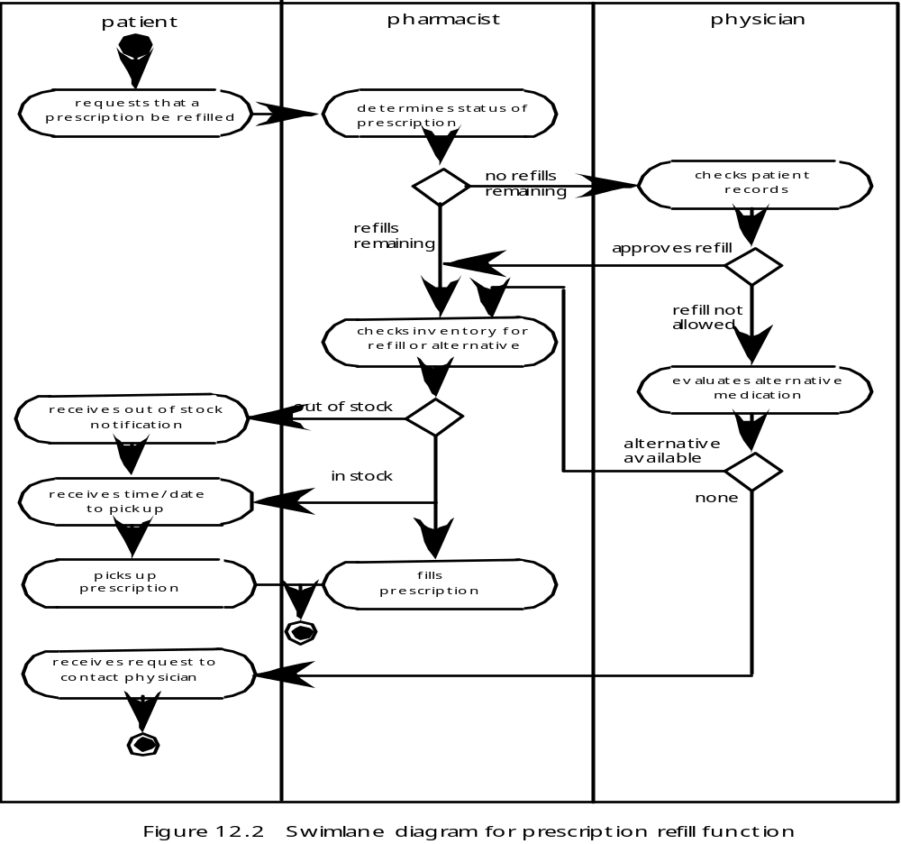
Interface Analysis
Swimlane Diagram

Slide 30
Interface Analysis
Analysis of Display Content
Are different types of data assigned to consistent geographic locations on the screen (e.g., photos always appear in the upper right hand corner)?
Can the user customize the screen location for content?
Is proper on-screen identification assigned to all content?
If a large report is to be presented, how should it be partitioned for ease of understanding?
Will mechanisms be available for moving directly to summary information for large collections of data.
Will graphical output be scaled to fit within the bounds of the display device that is used?
How will color to be used to enhance understanding?
How will error messages and warning be presented to the user?

Slide 31
Interface Design Steps
Using information developed during interface analysis, define interface objects and actions (operations).
Define events (user actions) that will cause the state of the user interface to change. Model this behavior.
Depict each interface state as it will actually look to the end-user.
Indicate how the user interprets the state of the system from information provided through the interface.

Slide 32
Interface Design Steps
Design Issues
Response time
Help facilities
Error handling
Menu and command labeling
Application accessibility
Internationalization

Slide 33
WebApp and Mobile Interface Design
Interface Design Principles - I
Anticipation—A WebApp should be designed so that it anticipates the use’s next move.
Communication—The interface should communicate the status of any activity initiated by the user
Consistency—The use of navigation controls, menus, icons, and aesthetics (e.g., color, shape, layout)
Controlled autonomy—The interface should facilitate user movement throughout the WebApp, but it should do so in a manner that enforces navigation conventions that have been established for the application.
Efficiency—The design of the WebApp and its interface should optimize the user’s work efficiency, not the efficiency of the Web engineer who designs and builds it or the client-server environment that executes it.

Slide 34
WebApp and Mobile Interface Design
Interface Design Principles - II
Focus—The WebApp interface (and the content it presents) should stay focused on the user task(s) at hand.
Fitt’s Law—“The time to acquire a target is a function of the distance to and size of the target.”
Human interface objects—A vast library of reusable human interface objects has been developed for WebApps.
Latency reduction—The WebApp should use multi-tasking in a way that lets the user proceed with work as if the operation has been completed.
Learnability— A WebApp interface should be designed to minimize learning time, and once learned, to minimize relearning required when the WebApp is revisited.

Slide 35
WebApp and Mobile Interface Design
Interface Design Principles-III
Maintain work product integrity—A work product (e.g., a form completed by the user, a user specified list) must be automatically saved so that it will not be lost if an error occurs.
Readability—All information presented through the interface should be readable by young and old.
Track state—When appropriate, the state of the user interaction should be tracked and stored so that a user can logoff and return later to pick up where she left off.
Visible navigation—A well-designed WebApp interface provides “the illusion that users are in the same place, with the work brought to them.”

Slide 36
WebApp and Mobile Interface Design
Interface Design Workflow-I
Review information contained in the analysis model and refine as required.
Develop a rough sketch of the WebApp interface layout.
Map user objectives into specific interface actions.
Define a set of user tasks that are associated with each action.
Storyboard screen images for each interface action.
Refine interface layout and storyboards using input from aesthetic design.

Slide 37
WebApp and Mobile Interface Design
Interface Design Workflow-II
Identify user interface objects that are required to implement the interface.
Develop a procedural representation of the user’s interaction with the interface.
Develop a behavioral representation of the interface.
Describe the interface layout for each state.
Refine and review the interface design model.

Slide 38
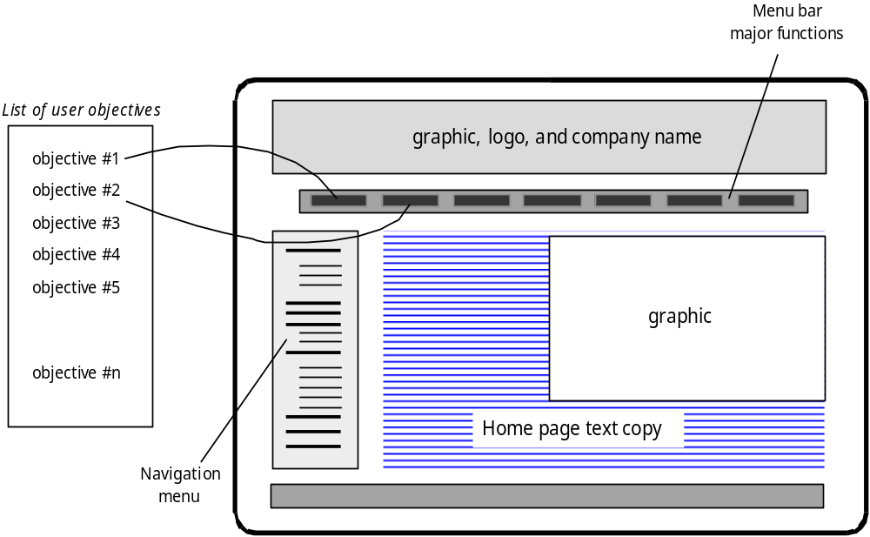
WebApp and Mobile Interface Design
Mapping User Objectives

Slide 39
Design Patterns
Effective Patterns
Coplien [Cop05] characterizes an effective design pattern in the following way:
  It solves a problem: Patterns capture solutions, not just abstract principles or strategies.
  It is a proven concept: Patterns capture solutions with a track record, not theories or speculation.
  The solution isn't obvious: Many problem-solving techniques (such as software design paradigms or methods) try to derive solutions from first principles. The best patterns generate a solution to a problem indirectly--a necessary approach for the most difficult problems of design.
  It describes a relationship: Patterns don't just describe modules, but describe deeper system structures and mechanisms.
  The pattern has a significant human component (minimize human intervention). All software serves human comfort or quality of life; the best patterns explicitly appeal to aesthetics and utility.

Slide 40
Design Patterns
Kinds of Patterns
Architectural patterns describe broad-based design problems that are solved using a structural approach.
Data patterns describe recurring data-oriented problems and the data modeling solutions that can be used to solve them.
Component patterns (also referred to as design patterns) address problems associated with the development of subsystems and components, the manner in which they communicate with one another, and their placement within a larger architecture
Interface design patterns describe common user interface problems and their solution with a system of forces that includes the specific characteristics of end-users.
WebApp patterns address a problem set that is encountered when building WebApps and often incorporates many of the other patterns categories just mentioned.

Slide 41
Design Patterns
Kinds of Patterns
Creational patterns focus on the “creation, composition, and representation of objects, e.g.,
  Abstract factory pattern: centralize decision of what factory to instantiate
  Factory method pattern: centralize creation of an object of a specific type choosing one of several implementations
Structural patterns focus on problems and solutions associated with how classes and objects are organized and integrated to build a larger structure, e.g.,
  Adapter pattern: 'adapts' one interface for a class into one that a client expects
  Aggregate pattern: a version of the Composite pattern with methods for aggregation of children
Behavioral patterns address problems associated with the assignment of responsibility between objects and the manner in which communication is effected between objects, e.g.,
  Chain of responsibility pattern: Command objects are handled or passed on to other objects by logic-containing processing objects
  Command pattern: Command objects encapsulate an action and its parameters

Slide 42
Design Patterns
Frameworks
Patterns themselves may not be sufficient to develop a complete design.
  In some cases it may be necessary to provide an implementation-specific skeletal infrastructure, called a framework, for design work.
  That is, you can select a “reusable mini-architecture that provides the generic structure and behavior for a family of software abstractions, along with a context … which specifies their collaboration and use within a given domain.” [Amb98]
A framework is not an architectural pattern, but rather a skeleton with a collection of “plug points” (also called hooks and slots) that enable it to be adapted to a specific problem domain.
  The plug points enable you to integrate problem specific classes or functionality within the skeleton.

Slide 43
Design Patterns
Describing a Pattern
Pattern name—describes the essence of the pattern in a short but expressive name
Problem—describes the problem that the pattern addresses
Motivation—provides an example of the problem
Context—describes the environment in which the problem resides including application domain
Forces—lists the system of forces that affect the manner in which the problem must be solved; includes a discussion of limitation and constraints that must be considered
Solution—provides a detailed description of the solution proposed for the problem
Intent—describes the pattern and what it does
Collaborations—describes how other patterns contribute to the solution
Consequences—describes the potential trade-offs that must be considered when the pattern is implemented and the consequences of using the pattern
Implementation—identifies special issues that should be considered when implementing the pattern
Known uses—provides examples of actual uses of the design pattern in real applications
Related patterns—cross-references related design patterns

Slide 44
Design Patterns
Pattern Languages
A pattern language encompasses a collection of patterns
  each described using a standardized template and
  interrelated to show how these patterns collaborate to solve problems across an application domain.
a pattern language is analogous to a hypertext instruction manual for problem solving in a specific application domain.
  The problem domain under consideration is first described hierarchically, beginning with broad design problems associated with the domain and then refining each of the broad problems into lower levels of abstraction.

Slide 45
Pattern-Based Design
A software designer begins with a requirements model (either explicit or implied) that presents an abstract representation of the system.
The requirements model describes the problem set, establishes the context, and identifies the system of forces that hold sway.
Then …

Slide 46
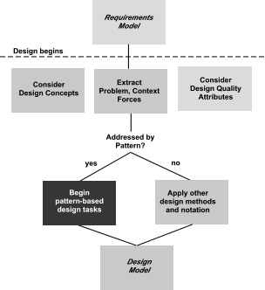
Pattern-Based Design

Slide 47
Pattern-Based Design
Thinking in Patterns
Shalloway and Trott suggest the following approach that enables a designer to think in patterns:
  Be sure you understand the big picture—the context in which the software to be built resides. The requirements model should communicate this to you.
  Examining the big picture, extract the patterns that are present at that level of abstraction.
  Begin your design with ‘big picture’ patterns that establish a context or skeleton for further design work.
  “Work inward from the context” [Sha05] looking for patterns at lower levels of abstraction that contribute to the design solution.
  Repeat steps 1 to 4 until the complete design is fleshed out.
  Refine the design by adapting each pattern to the specifics of the software you’re trying to build.

Slide 48
Pattern-Based Design
Design Tasks—I
Examine the requirements model and develop a problem hierarchy.
Determine if a reliable pattern language has been developed for the problem domain.
Beginning with a broad problem, determine whether one or more architectural patterns are available for it.
Using the collaborations provided for the architectural pattern, examine subsystem or component level problems and search for appropriate patterns to address them.
Repeat steps 2 through 5 until all broad problems have been addressed.

Slide 49
Pattern-Based Design
Design Tasks—II
If user interface design problems have been isolated (this is almost always the case), search the many user interface design pattern repositories for appropriate patterns.
Regardless of its level of abstraction, if a pattern language and/or patterns repository or individual pattern shows promise, compare the problem to be solved against the existing pattern(s) presented.
Be certain to refine the design as it is derived from patterns using design quality criteria as a guide.

Slide 50
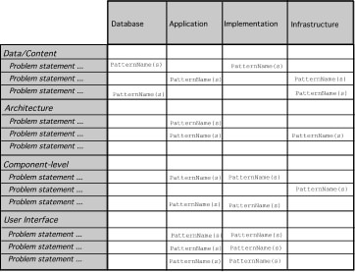
Pattern-Based Design
Pattern Organizing Table

Slide 51
Pattern-Based Design
Common Design Mistakes
Not enough time has been spent to understand the underlying problem, its context and forces, and as a consequence, you select a pattern that looks right, but is inappropriate for the solution required.
Once the wrong pattern is selected, you refuse to see your error and force fit the pattern.
In other cases, the problem has forces that are not considered by the pattern you’ve chosen, resulting in a poor or erroneous fit.
Sometimes a pattern is applied too literally and the required adaptations for your problem space are not implemented.

Slide 52
Architectural Patterns
Example: every house (and every architectural style for houses) employs a Kitchen pattern.
The Kitchen pattern and patterns it collaborates with address problems associated with the storage and preparation of food, the tools required to accomplish these tasks, and rules for placement of these tools relative to workflow in the room.
In addition, the pattern might address problems associated with counter tops, lighting, wall switches, a central island, flooring, and so on.
Obviously, there is more than a single design for a kitchen, often dictated by the context and system of forces. But every design can be conceived within the context of the ‘solution’ suggested by the Kitchen pattern.

Slide 53
Architectural Patterns
Patterns Repositories
There are many sources for design patterns available on the Web. Some patterns can be obtained from individually published pattern languages, while others are available as part of a patterns portal or patterns repository.
A list of patterns repositories is presented in the sidebar near Section 12.3

Slide 54
Component-Level Design Patterns
Component-level design patterns provide a proven solution that addresses one or more sub-problems extracted from the requirement model.
In many cases, design patterns of this type focus on some functional element of a system.
For example, the SafeHomeAssured.com application must address the following design sub-problem: How can we get product specifications and related information for any SafeHome device?

Slide 55
Component-Level Design Patterns
Component-Level Design Patterns
Having enunciated the sub-problem that must be solved, consider context and the system of forces that affect the solution.
Examining the appropriate requirements model use case, the specification for a SafeHome device (e.g., a security sensor or camera) is used for informational purposes by the consumer.
  However, other information that is related to the specification (e.g., pricing) may be used when e-commerce functionality is selected.
The solution to the sub-problem involves a search. Since searching is a very common problem, it should come as no surprise that there are many search-related patterns.

Slide 56
User Interface (UI) Design Patterns
Whole UI. Provide design guidance for top-level structure and navigation throughout the entire interface.
Page layout. Address the general organization of pages (for Websites) or distinct screen displays (for interactive applications)
Forms and input. Consider a variety of design techniques for completing form-level input.
Tables. Provide design guidance for creating and manipulating tabular data of all kinds.
Direct data manipulation. Address data editing, modification, and transformation.
Navigation. Assist the user in navigating through hierarchical menus, Web pages, and interactive display screens.
Searching. Enable content-specific searches through information maintained within a Web site or contained by persistent data stores that are accessible via an interactive application.
Page elements. Implement specific elements of a Web page or display screen.
E-commerce. Specific to Web sites, these patterns implement recurring elements of e-commerce applications.

Slide 57
WebApp Patterns
Information architecture patterns relate to the overall structure of the information space, and the ways in which users will interact with the information.
Navigation patterns define navigation link structures, such as hierarchies, rings, tours, and so on.
Interaction patterns contribute to the design of the user interface. Patterns in this category address how the interface informs the user of the consequences of a specific action; how a user expands content based on usage context and user desires; how to best describe the destination that is implied by a link; how to inform the user about the status of an on-going interaction, and interface related issues.
Presentation patterns assist in the presentation of content as it is presented to the user via the interface. Patterns in this category address how to organize user interface control functions for better usability; how to show the relationship between an interface action and the content objects it affects, and how to establish effective content hierarchies.
Functional patterns define the workflows, behaviors, processing, communications, and other algorithmic elements within a WebApp.

Slide 58
WebApp Patterns
Design Granularity
When a problem involves “big picture” issues, attempt to develop solutions (and use relevant patterns) that focus on the big picture.
Conversely, when the focus is very narrow (e.g., uniquely selecting one item from a small set of five or fewer items), the solution (and the corresponding pattern) is targeted quite narrowly.
In terms of the level of granularity, patterns can be described at the following levels:

Slide 59
WebApp Patterns
Design Granularity
Architectural patterns. This level of abstraction will typically relate to patterns that define the overall structure of the WebApp, indicate the relationships among different components or increments, and define the rules for specifying relationships among the elements (pages, packages, components, subsystems) of the architecture.
Design patterns. These address a specific element of the design such as an aggregation of components to solve some design problem, relationships among elements on a page, or the mechanisms for effecting component to component communication. An example might be the Broadsheet pattern for the layout of a WebApp homepage.
Component patterns. This level of abstraction relates to individual small-scale elements of a WebApp. Examples include individual interaction elements (e.g. radio buttons, text books), navigation items (e.g. how might you format links?) or functional elements (e.g. specific algorithms).

Slide 60
Pattern for Mobile Apps
Typical examples
Check-in screens
Maps
Popovers
Sign-up Flows
Custom Tab Navigation
Invitations

Slide 61
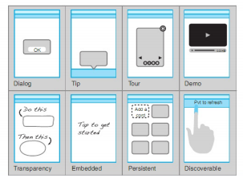
Pattern for Mobile Apps
Examples of mobile invitation patterns

Slide 62
References
Pressman, R.S. (2010). Software Engineering : A Practioner's Approach. 8^{h} ed. McGraw-Hill Companies.Inc, Americas, New York. ISBN : 978 1 259 253157.
Architecture component, http://technet.microsoft.com/en-us/library/cc263121.aspx
High level SW Design,
http://www.the-software-experts.de/e_dta-sw-design-high-level.htm

Slide 63
Q & A

